Slide 1
Image Captioning of Earth Observation Imagery
MDS-MDA Joint Capstone Project
Dora Qian, Fanli Zhou, James Huang, Mike Chen

Slide 2
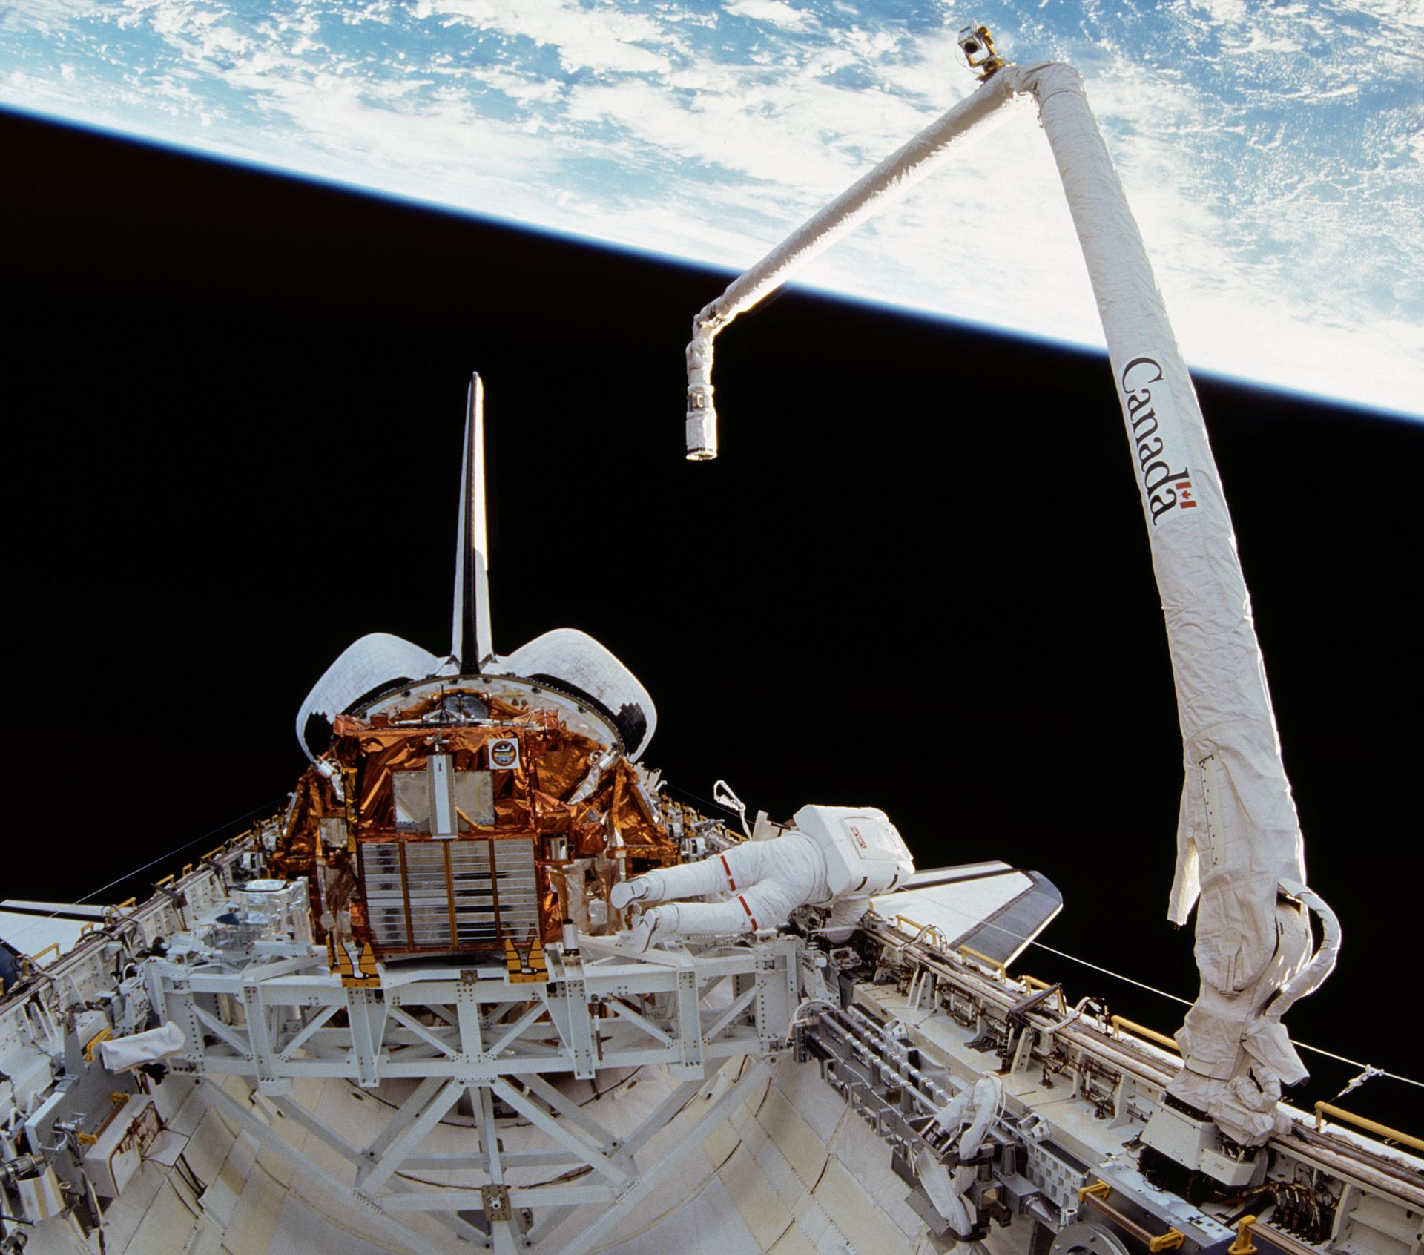
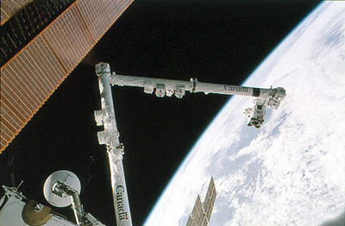
MDA
A Canadian aerospace company
Developed Canadarm and Canadarm2

Slide 3
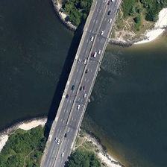
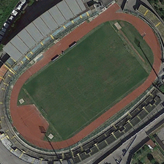
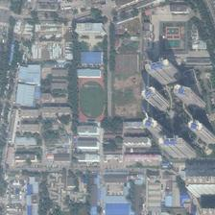
Data Science Problem and Motivation
Access to a vast database of uncaptioned satellite images
We aim to caption these images
Associating an image with a caption makes it accessible
Sort images based on content
Return queries
Evaluate similarity

Slide 4
Overall Goal
Develop a pipeline
Given a set of labelled satellite images, develop an end-to-end image captioning system.
Create a visualization tool
Aim to help users interact with model and data

Slide 5
Specific Objectives
Data preprocessing
Transform and store data in a well-defined and reproducible structure
Model development
Extract features from image
Generate sentence from features
Model evaluation
Apply n-gram based and semantic similarity based evaluation metrics
Visualization
Generate captions for unseen user uploaded images, and upload results to the database
View previously generated image/caption pairs and evaluation scores

Slide 6
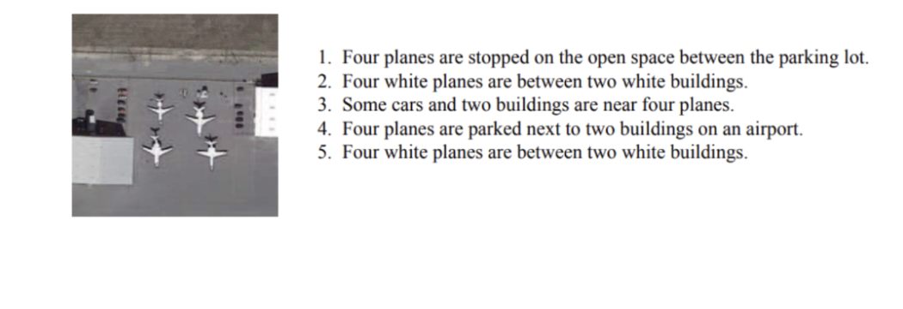
The Data
UCM_captions
RSICD (Remote Sensing Imaging Captioning Dataset)
Sydney_captions
Training on UCM_captions and RSICD, testing on Sydney_captions

Slide 7
CUTOFF
ALL PREVIOUS SLIDES ARE INTRODUCTION
ALL FUTURE SLIDES ARE CONCLUSION

Slide 8
Conclusion
We have been successful in creating a functional data pipeline and visualization tool
Our goals were met and all the features we aimed to create are available
Performance of the model is fair
We hope that MDA can iterate and improve upon our work

Slide 9
Limitations
Relatively small dataset
Poor performance of CNN feature extraction models trained from scratch
Using pre-trained model trained on ImageNet type images
Attention model did not perform as expected
The captions were not significantly improved and was at times worse
Short project time
Lacked time to add or fine tune more layers

Slide 10
Recommendations
Explore training a CNN feature extraction model from scratch
Use much larger captioned satellite image datasets available online
Fix or refine attention model
A well implemented attention model should yield better results
Add or fine tune model layers
More comprehensive cross-dataset performance evaluation

